Slide 1
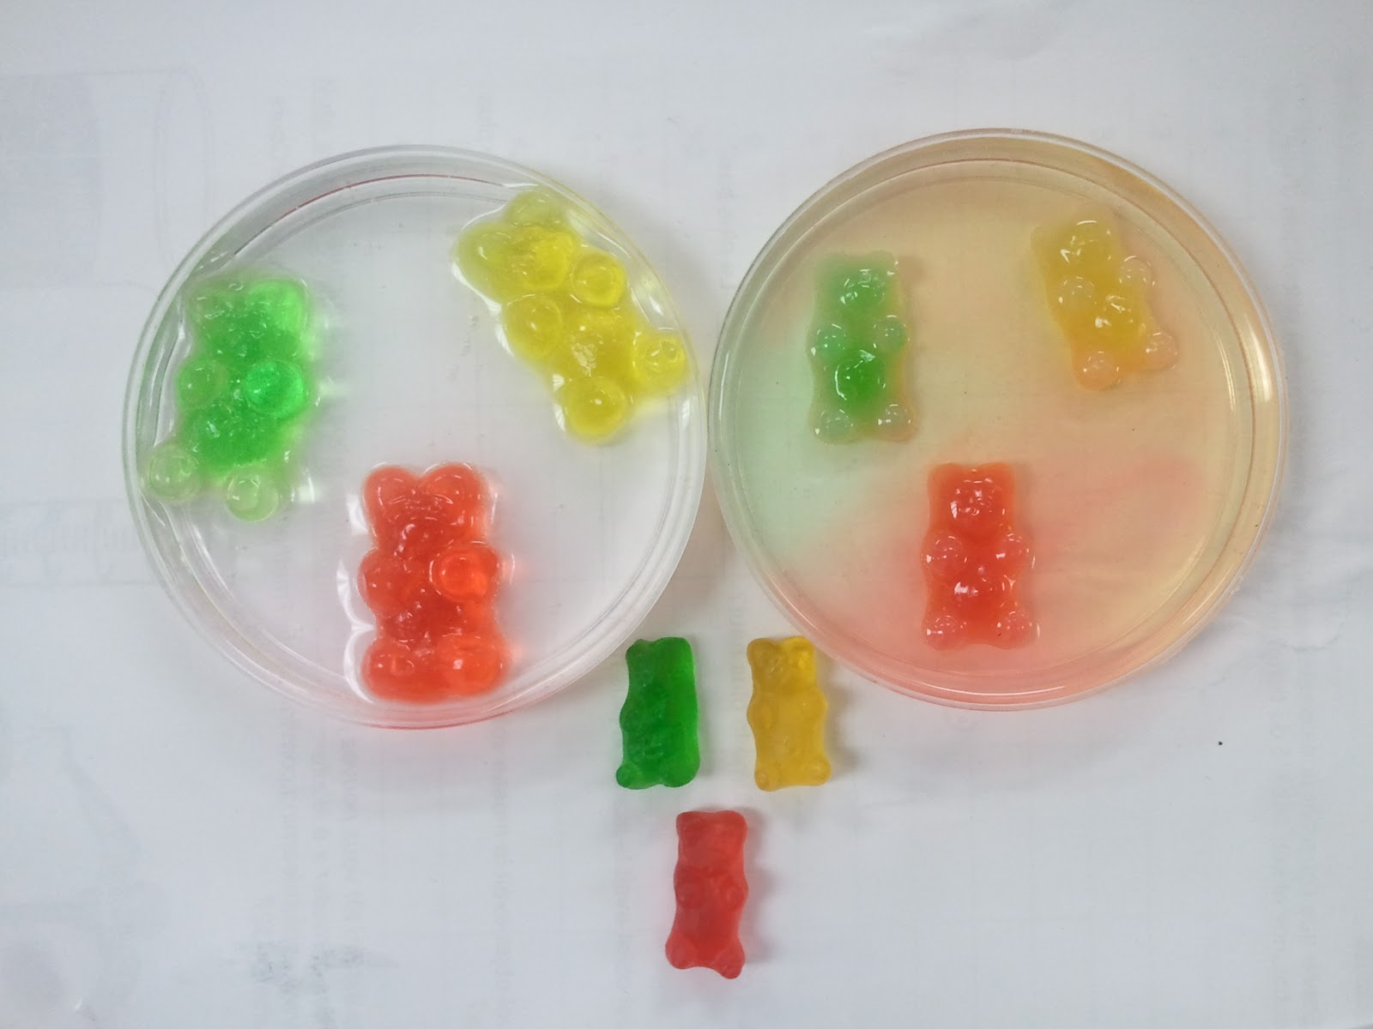
Why did the gummy bears change?
Gummy bears in plain water
Gummy bears in sugar water
Gummy bears in no water

Slide 2
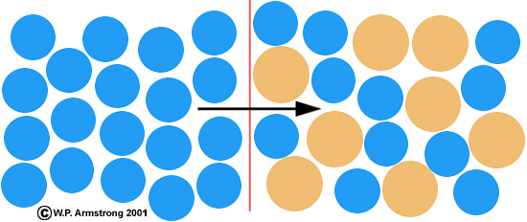
Osmosis
When water moves from an area of higher concentration to low concentration across a membrane.
membrane
water

Slide 3
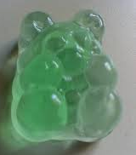
Osmosis and gummy bears
Higher concentration of water
The gummy bear is a membrane – it lets water move in and out of the gummy bear
The gummy bear in the plain water had higher concentration of water outside it and lower concentration of inside it
So water will move from outside the bear to inside the bear. This makes the bear grow larger.
Lower concentration of water

Slide 4
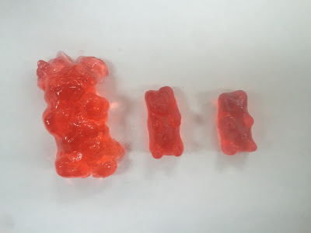
Osmosis of gummy bears
Explain what happened with the gummy bear in sugar water
Remember osmosis is when water moves from a higher concentration to a lower concentration through a membrane
Gummy bear in plain water
Gummy bear in no water
Gummy bear in sugar water

Slide 5
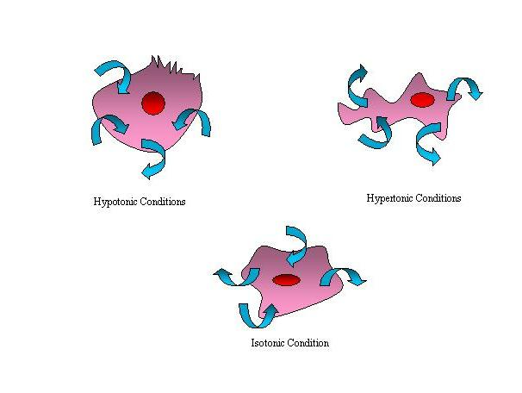
Osmosis and the cell membrane
This is why your body works very hard to maintain a constant environment at all times.
Your body always tries to have the same amount of water, no matter how much or little you drink
Water concentration outside is the same as inside
Water concentration outside is lower than inside
Water concentration outside is higher than inside

Slide 6
Now your turn to explain
It is now your turn to EXPLAIN the SCIENCE behind what happened to the gummy bears.
Complete this passage and post it onto Edmodo:
The gummy bear in plain water increased in volume because of osmosis …
The gummy bear in sugar water ____________ in volume because of osmosis …

